Slide 1

Sexuality and Our Diversity:
Integrating Culture with the Biopsychosocial
Professor Michael J. McGee, PhD

Slide 2
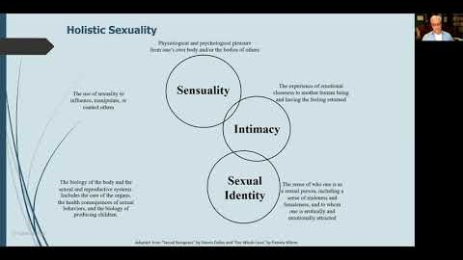

Slide 3
CHAPTER 1
Perspectives on Sexuality in a Cultural and Historical Context

Slide 4

Common Terms
Sexology: scientific study of sexuality.
Gender: behavioral, social, and cultural manifestations of femaleness or maleness.
Biological sex: genetic, hormonal, anatomical, and functional manifestations of femaleness and maleness.
Identity: the way people:
  Perceive themselves or some aspect of self.
  Represent themselves to others.

Slide 5

Holistic Sexuality
Physiological and psychological pleasure
from one’s own body and/or the bodies of others
Sensuality
The experience of emotional closeness to another human being and having the feeling returned
The use of sexuality to influence, manipulate, or control others
Sexualization
Intimacy
Sexual Health
& Reproduction
Sexual
Identity
The biology of the body and the
sexual and reproductive systems. Includes the care of the organs,
the health consequences of sexual behaviors, and the biology of producing children.
The sense of who one is as a sexual person, including a sense of maleness and femaleness, and to whom one is erotically and emotionally attracted
Adapted from “Sexual Beingness” by Dennis Dailey and “Our Whole Lives” by Pamela Wilson

Slide 6


Being Weird
WEIRD stands for Western, Educated, Industrialized, Rich, and Democratic.
Socioeconomic and educational factors have an impact both directly and indirectly on many aspects of gender and sexuality.
A poor person from a rich economy is wealthier than a typical person from a developing economy.

Slide 7

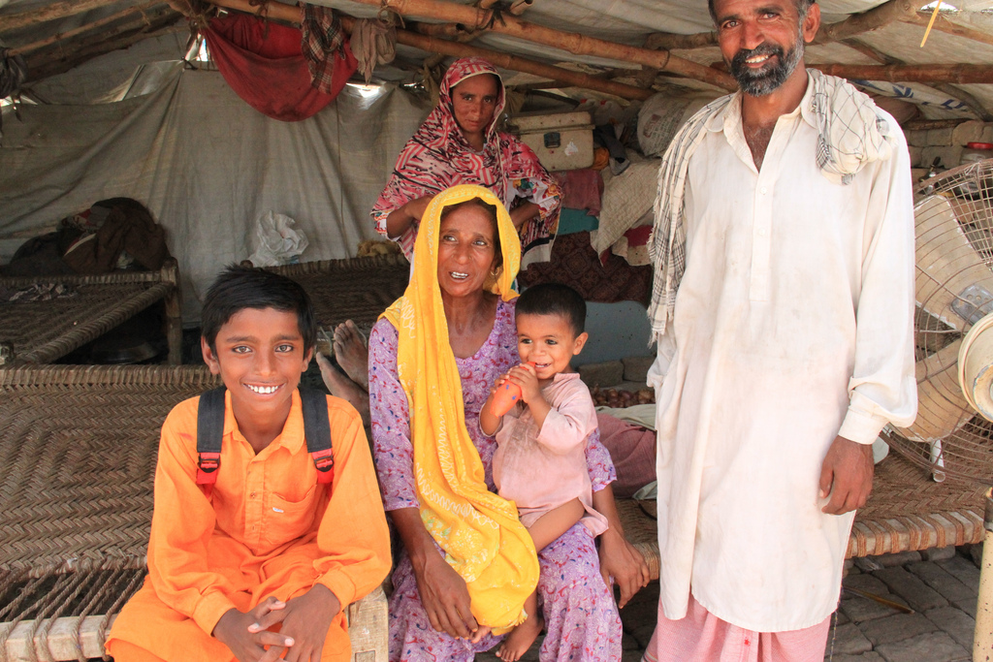
Major Distinctions between Cultures
One of the most profound psychological differences in cultures is whether one’s self-concept is independent or interdependent.
An interdependent sense of self is historically the most prevalent type of self-concept.
Distinction between urban versus rural or industrialized versus non-industrialized have a greater impact on people.

Slide 8
Finding Universals
Patterns can be found that suggest universals, contributing to shared experiences as humans across cultures, that are:
  Rooted in biology.
  Can be understood through evolution of species.
Difference in brain functioning is not sufficient to conclude a biological basis.

Slide 9
Current Cultural Issue
Conscience clause: refusal by a pharmacist to fill a woman’s prescription for contraceptives under some circumstances:
  Also called refusal to fill laws.
  Varies by state.
  Argument for the clause: protect the right to religious freedom and an important component of religious practice.
  Argument against the clause: businesses not allowed to enforce their beliefs on customers.

Slide 10
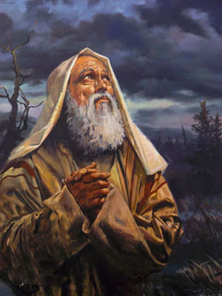
Greco-Roman and Abrahamic History
In Greece, it was considered appropriate for males to have two outlets for sexual desire and behavior:
  With women.
  With adolescent males.
Expectations in ancient Judaism were that sexual behavior was for procreation. Passages condemn:
  Male-male sexuality.
  Bestiality.
  Sin of Onan (wasting semen).

Slide 11
Greco-Roman and Abrahamic History
Traditional branches of Judaism today encourage:
  Sexual conservatism.
  Strict separation between the sexes.
  Modesty in clothes for both sexes.
  Women to cover their hair.
  Sexual expression to be directed toward procreation.
  Prohibition of sexual pleasure outside of marriage, masturbation, or same-sex relations.

Slide 12
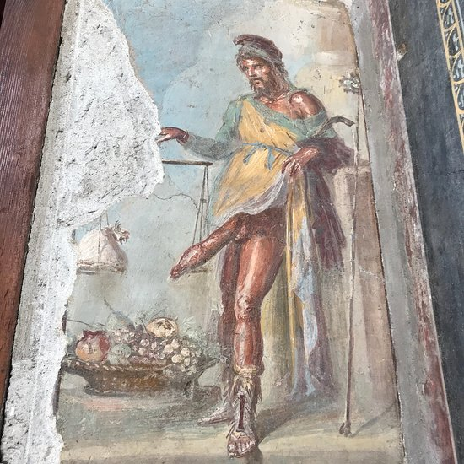
Greco-Roman and Abrahamic History
Archeological remains show that brothels and sex workers were a well-established part of Roman life.
Giant erect penises carved in stone can be seen in the ruins of Pompeii.
Patriarchal: social structure where power, wealth, property, and status are controlled by males:
  Greek and Roman cultures were primarily patriarchal.
“Just” war theory: idea of St. Augustine’s that a war can be moral and good.

Slide 13
Decorations from the Brothels of Ancient Pompeii and Herculaneum

Slide 14
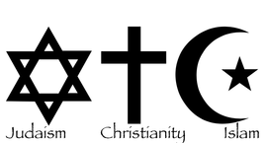
Global Influence of Abrahamic Religions
  Abrahamic religions: Judaism, Christianity, and Islam:
    Reflected the patriarchal structures of Mediterranean antiquity, with males controlling property, wealth, and power.
  Contemporary branches of Judaism include:
    Reform: liberal attitudes on sexuality.
    Orthodox: sexuality as being for procreative purposes between a husband and wife.
    Conservative: between those of the Reform and Orthodox communities.

Slide 15
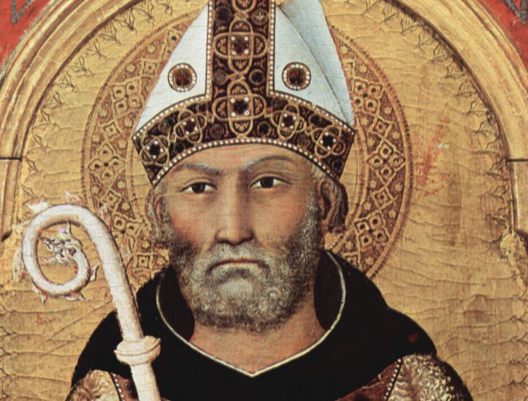
Global Influence of Abrahamic Religions
St. Augustine’s proscriptions contribute to Catholic opposition to contraception.
Evangelicalism and Evangelical Christianity: conservative branch of Protestantism
  Emphasizes a conservative view of sexuality.
In the most traditional sects of faith:
  Sex for sexual pleasure is sinful.
  Pornography is prohibited.
  Sexual portrayals in television is restricted.

Slide 16
Religion, Sexism, and Politics
Dichotomous view of women underlies a sexual double standard:
  Women were seen as being innately sexually chaste, incapable of and uninterested in enjoying sexual pleasure.
  Women who did enjoy sexual pleasure were looked down upon.
Abrahamic and Greco-Roman traditions have had some influence on ideas of gender and sexuality for the majority of countries.

Slide 17

Agriculture and Industrialization
Despite immense linguistic and cultural differences, most societies developed patriarchal structures after adopting agriculture.
Industrialization, urban living, and a shared cultural experience have had an impact on gender and sexuality:
  Reliable oral contraceptives.
  Women choosing to have smaller families.
  Shift in societal gender roles.

Slide 18
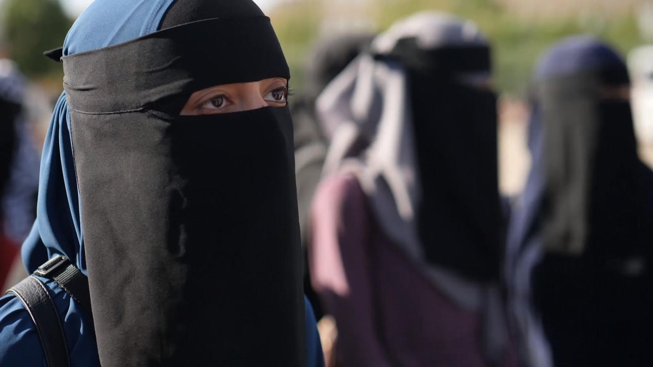

Media and the Internet
Many countries are more restrictive of material that has nudity or sexual content than material that has violence.
Internet serves to reinforce traditional cultural values, providing communities in which people with like-minded views can gather.
Modern media has brought about a major influence on body image.

Slide 19
Western European and Anglo-American Culture
The Western cultures include a diverse range of countries, languages, and cultures originally from Europe:
  Mediterranean cultures have historically been Catholic, with Christian traditions on sexuality and gender roles.
  Nordic countries were early converts to Lutheranism.
  The Netherlands has a distinct culture and linguistic tradition.
In recent decades Germany has become among the more liberal of industrialized countries with regards to sexuality.
English physicians and scientists, along with French and Germans, pathologized many forms of sexual expression as mental illness.
Migration into a region influences gender roles and sexuality:
  Acculturation impacts people’s views and beliefs.

Slide 20
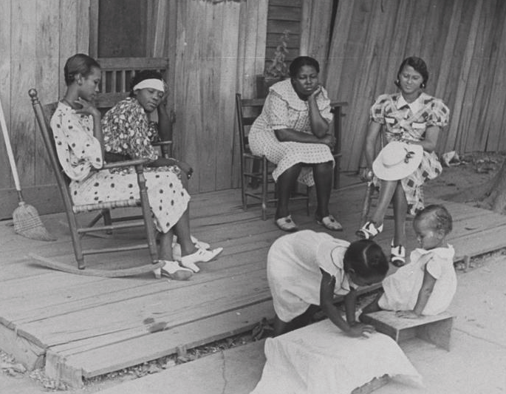
African American Experience
Enslavement was rampant in British colonies:
  In the United States, children of enslaved people were themselves considered to be property.
  Enslaved females were raped, and this was not construed as a crime.
  Severe levels of physical punishment were very common.
  Males were often forcibly removed from families to be sold, leaving matriarchal families.
Modern matriarchal structures include networks of female relatives helping to raise children.
In the United States, legalized discrimination against African Americans was prevalent until the 1960s:
  No access to education
  Unemployment
Maternal mortality among Black women is rising in the U.S.
  Black, American Indian, and Alaska Native (AI/AN) women are two to three times more likely to die from pregnancy-related causes than white women

Slide 21

African American Experience
African American males are incarcerated at higher rates than white males for the same crimes.
  Effects of poverty correlated with higher rates of:
  Teenage pregnancy
  Single parent families
  Limited access to health care and education
  STIs
Both white and African American evangelical Christians shared a relatively negative attitude toward same-sex attraction and marriage.

Slide 22
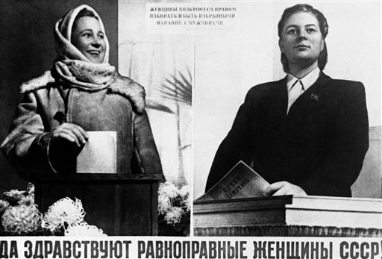
Eastern Europe and Russia
Majority cultures of Russia and the Baltic and Slavic countries of Eastern Europe were predominantly Orthodox Christian, with a patriarchal society.
Soviet communists provided aggressive opportunities for university education and professional training for women:
  Practice of religion was made difficult.
  Beliefs about sexuality were set aside.
Soviet era was a time of sexual equality in some aspects of gender roles but also enhanced repression in individual sexual expression.
After the fall of communism:
  Ready access to contraceptives and abortion.
  Negative attitudes against same-sex relations.

Slide 23

Latino and Hispanic Cultures and the Americas
Spanish-influenced regions and peoples are referred to as Hispanic cultures:
  Latino American and Latina American: males and females in the United States who are of Latino or Hispanic descent.
  Latinx: a gender-neutral word for people of Latin American descent.
Catholic-influenced views of sexuality are common.

Slide 24
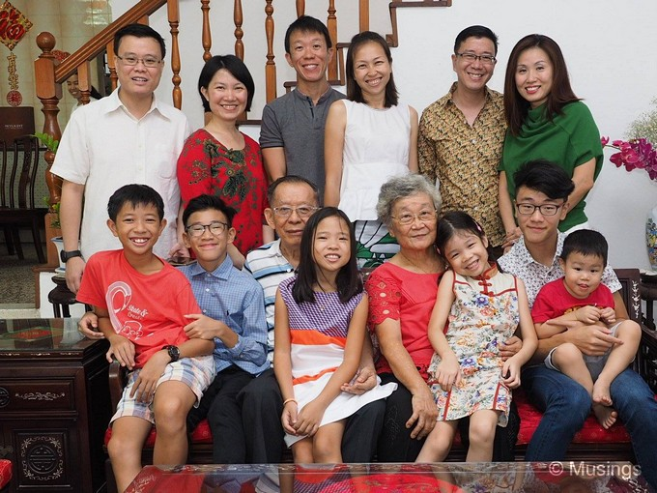
Northeast Asian Cultures
Confucius had a liberal attitude toward sexuality:
  Idea of yin and yang requiring a balance of forces.
Ancient traditions of Taoism, part religion and part philosophy, suggested sexuality was part of the natural order.
China now has a wide diversity of cultural attitudes toward sexuality:
  Same-sex relationships not approved of.
Part of the Confucian tradition is the concept of filial piety, or the importance of fulfilling one’s duty and obligations to family:
  Brought about importance for masculinity.
  Having male offspring considered important.
  Selective abortion of female fetuses and selective screening of sperm brought about a change in the gender ratio.

Slide 25
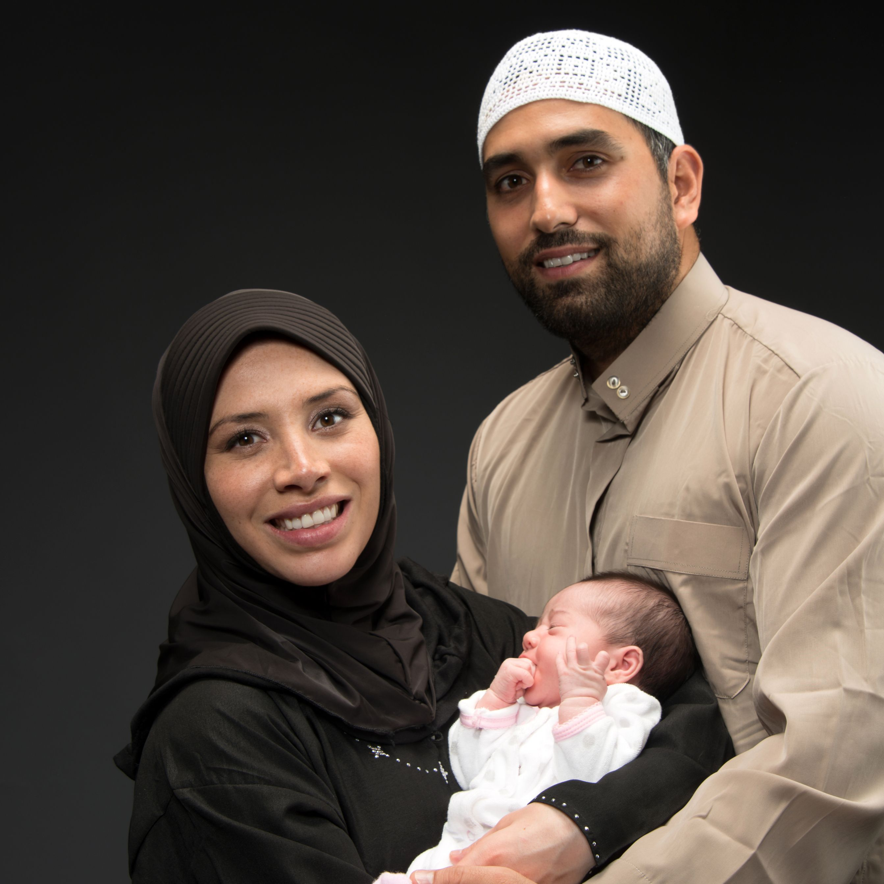
Middle Eastern and North African Cultures
Islam was practiced with a more liberal interpretation in urban and settled agricultural civilizations than in the tribal regions:
  In Iran, both women and men vote and wear Western-style dress.
  In Saudi Arabia, women were able to vote or run for office in 2015 for the first time, but only in local elections.
    Both sexes are expected to wear loose-fitting clothing in public and to cover their heads.
    Women face many legal restrictions on movement in public.

Slide 26
Middle Eastern and North African Cultures
Differences between cultures in interpretations of Islam are illustrated by variations in clothing emphasizing sexual modesty:
  Hijab: head-covering scarf.
  Niqab: face veil.
  Burqa: loose gown covering the body, a hijab, and a niqab and is required of women in public places.
It is argued that the clothing requirements represent:
  Oppression of women.
  Cultural and religious freedom.

Slide 27
Variety of Clothing Styles in Modern Turkey

Slide 28
Middle Eastern and North African Cultures
In poorer countries, pre-Islamic customs of female genital cutting continue.
Women have legal restrictions in their participation in government and business.
Polygamy is permitted, not polyandry.
In traditional cultures there exists a negative view of:
  Same-sex sexuality.
  Comprehensive sex education.
Homosexuality and adultery are punishable by death.

Slide 29
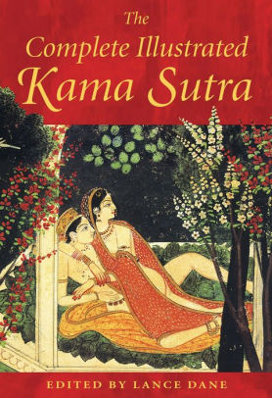
South Asian Cultures
Most populous country of South Asia is India, with majority of the people practicing Hinduism:
  Duality between the apparent physical world and an underlying interconnectedness.
World’s oldest surviving manual of sexuality and love, the Kama Sutra, dates to Hindu India.
Some traditions in Hinduism, now illegal, prevented a woman from marrying if her husband died or show her devotion by voluntarily burning herself.
Prohibitions on when sex can occur.

Slide 30
South Asian Cultures
Sikhism has both polytheistic and monotheistic variants:
  Adultery is considered sinful.
  Turban and no shaving of facial hair for males.
  Loose-fitting dress and covering of the hair for females.
In Buddhism, there is no negative view to sexuality, but material concerns and pleasures are viewed as a distraction from true enlightenment:
  Sexual scenes in temple art.

Slide 31
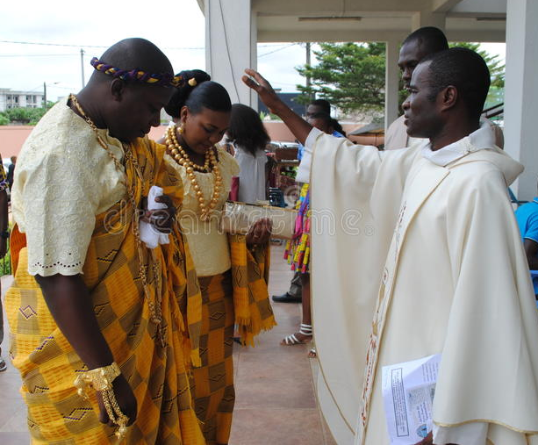
African Cultures
Hominid fossils in Africa show the appearance of anatomically modern humans.
Masculinity in some east African people is associated with bravery and strength:
  Polygamous family structures are common for males who have sufficient wealth.
Many African cultures attribute a sacred spiritual element to sexuality and procreation.

Slide 32
African Cultures
African countries have been used as a source of labor:
  Enslavement.
  Raw materials.
Lack of economic development for average citizens in many African nations has a great impact on sexual health:
  Highest levels of infectious diseases.
  Highest rates of children dying.
  Highest rates of mothers dying in childbirth.

Slide 33
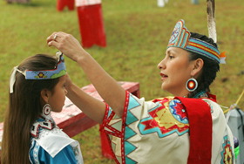
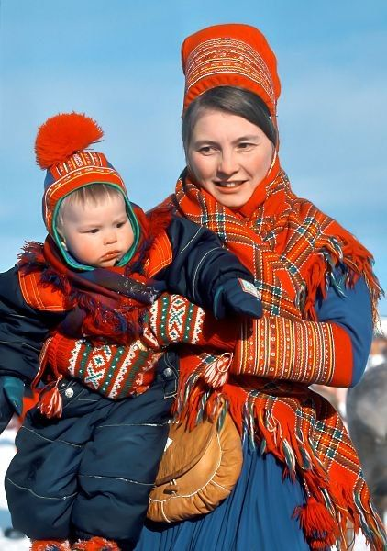
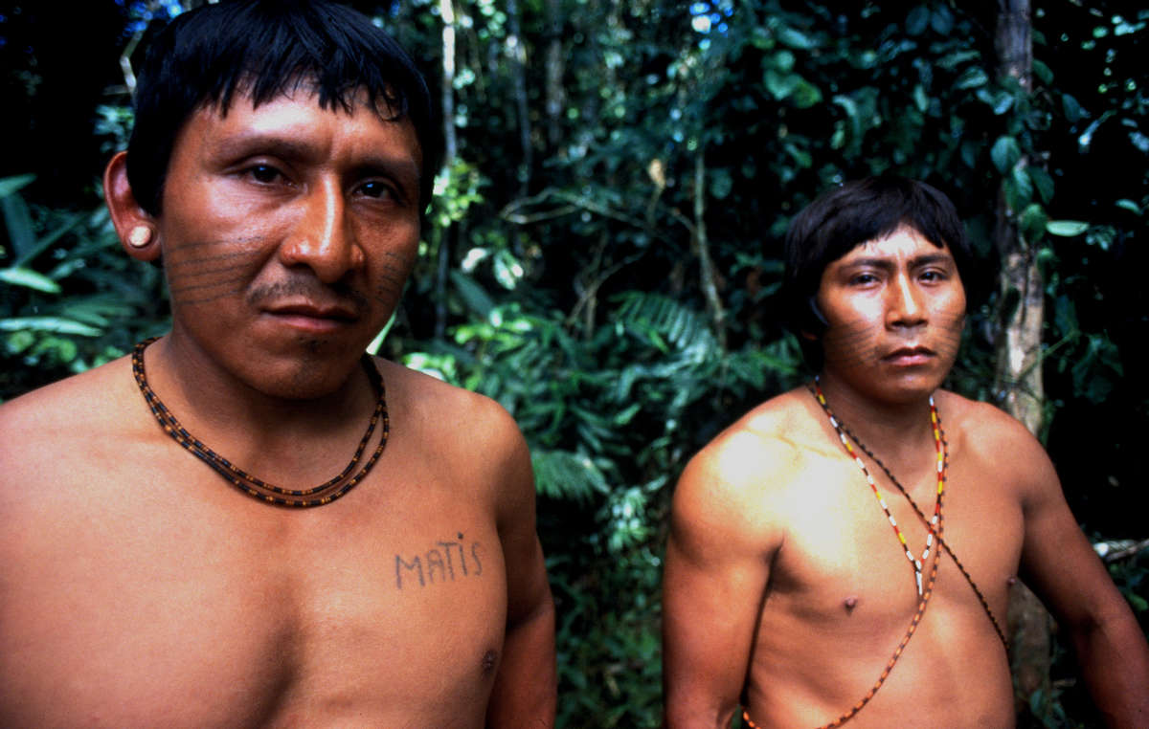
Indigenous Cultures
Refers to the first people in a geographic region:
  Native American Indians.
  First Nations Peoples in Canada.
  Sami people of northern Scandinavia.
Show enormous variation in both gender roles and sexuality:
  Musuo people in China: matriarchal structure.
  Yanomamo of the Amazon: partible paternity.
  Cheju Island in South Korea: inverted gender roles.
  Third sex: combines aspects of variance in gender identity, gender role conformity, or sexual orientation.
  Aka hunters in central Africa: sex considered a job for procreation.

Slide 34
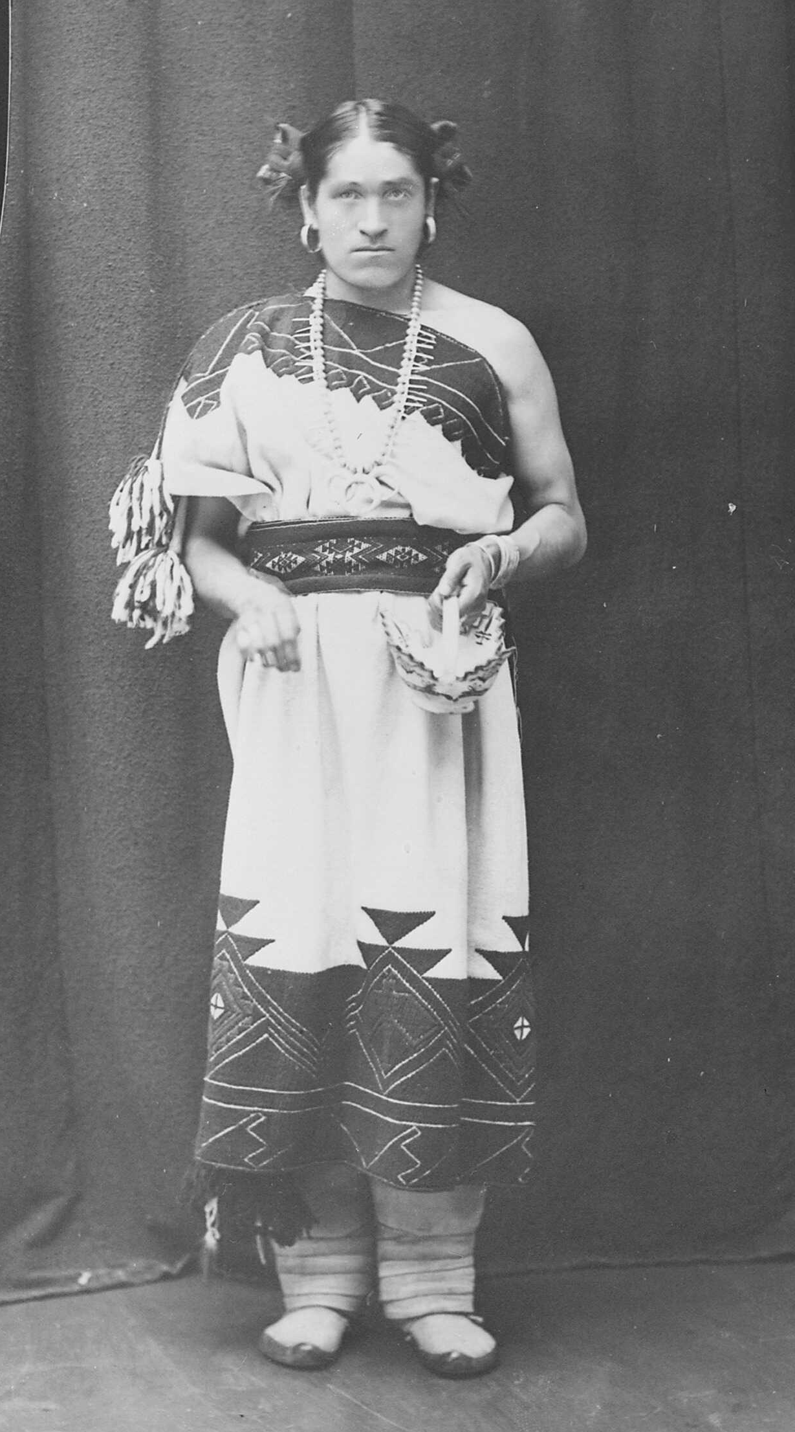
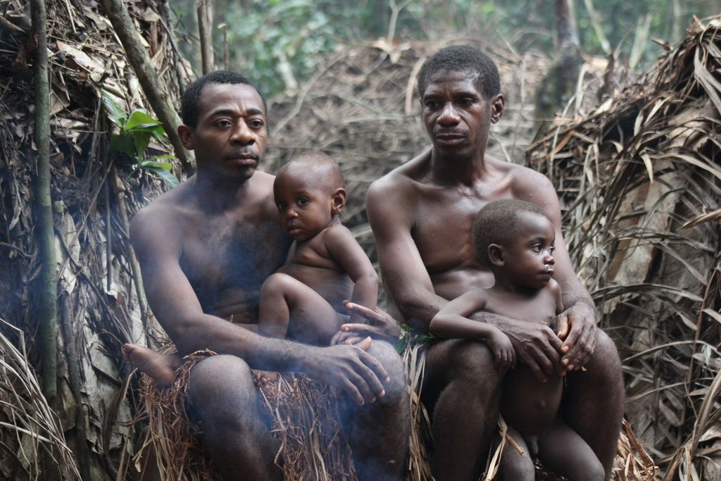

Indigenous Cultures
Show how flexible human nature can be with regard to what is considered:
  Gender-typical behavior.
  Normal sexual activity.
  Proper family structure.

Slide 35
1700s: Rise of the Scientific Method and Equality
Modern scientific method: process for learning about reality based on objective, verifiable evidence that permits ideas to be tested.
Idea of putting theories about nature to an empirical test rather than arguing on the basis of logic, faith, or experience was prevalent:
  Archimedes: experiments on volume and density.
  Zhang Heng: experiments on the nature of the moon and its relationship to eclipses.

Slide 36
1700s: Rise of the Scientific Method and Equality
Changes of the Enlightenment also brought a questioning of traditional Christian attitudes about the role of women.
Mary Wollstonecraft and Jeremy Bentham were philosophers who wrote about equality for females.
In European literature in the 1700s, there were accounts of people enjoying sexual pleasure without consideration for Christian ideals of morality:
  Casanova
  Don Juan

Slide 37
1800s: Gender Roles and Medicalization of Sex
Physicians started to make proclamations about human nature and sexuality that were actually based not on evidence but on the prevailing culture.
Double standard became common for sexual behavior outside of a marriage.
Psychopathia Sexualis by Richard von Krafft-Ebing documented a wide range of sexual practices; described as perversions and medical problems:
  Marks the first time that psychiatry claimed sexuality and sexual behavior as medical matters.

Slide 38
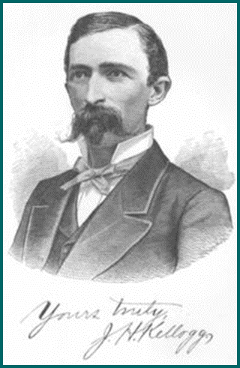
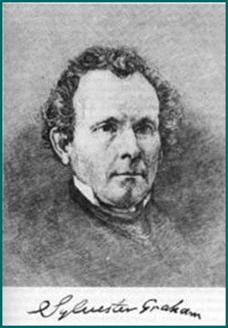
1800s: Gender Roles and Medicalization of Sex
Havelock Ellis and Magnus Hirschfeld suggested a biological basis for sexual orientation:
  Inversion of masculinity and femininity in same-sex attraction.
Foods were developed for the purpose of being bland so as to curb masturbation:
  It was thought that spicy food would ignite sexual passion.
    Kellogg’s corn flakes – John Kellogg, medical doctor and Adventist who advocated for a mild diet to reduce sexual feeling.
    Graham crackers – Sylvester Graham, a minister, advocated homemade bread from unbolted wheat, with which his name was ultimately identified, roused the ire of bakers.

Slide 39
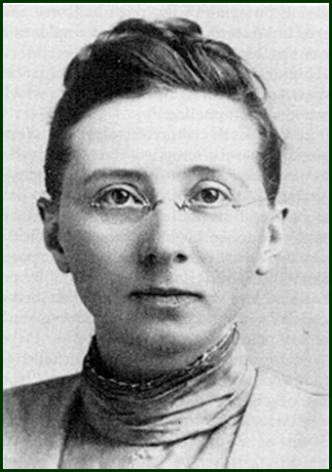
Research Focus
Clelia Duel Mosher, 1863–1940:
  Demonstration through experiments that constrictive clothing were constricting women’s diaphragms, thereby impacting breathing.
  Studies establishing that women were just as interested in sex as men.
  Documentation of the use of condoms and diaphragms.

Slide 40
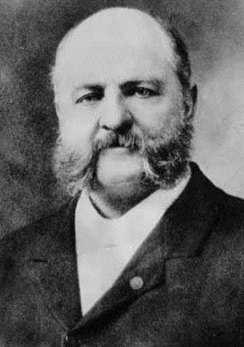
1800s: Gender Roles and Medicalization of Sex
Comstock laws were passed criminalizing abortion and preventing the sale of contraceptives
He authored the first federal obscenity law, prosecuting those who wrote, published, or sold material he deemed obscene
Same-sex sexual contact was also criminalized in many countries
  1814 - The term "Crime against nature" first used in the Criminal code in the United States.

Slide 41
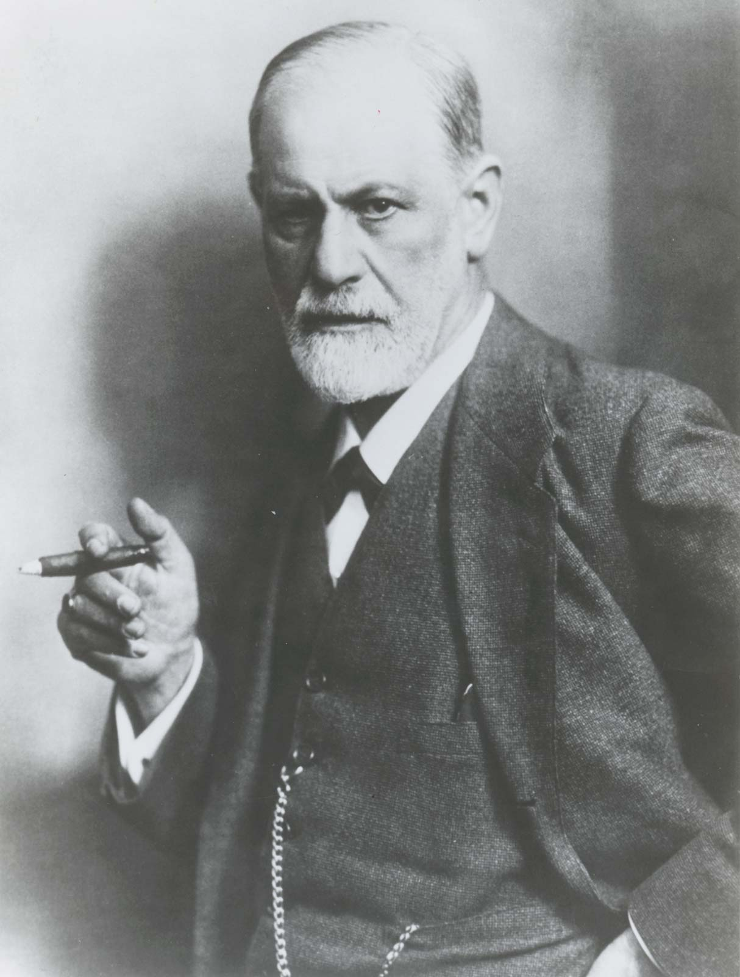
Through the Twentieth Century
Sigmund Freud: most influential figure for sexuality in the first half of the twentieth century:
  Developed a theory of mind.
  Invented talk-based psychotherapy as a solution for psychological problems.
Most contemporary psychologists use different techniques that focus on:
  Modifying conscious thoughts.
  Addressing interpersonal relations.

Slide 42
Through the Twentieth Century
Important change in the twentieth century was the right of women to vote.
1920s and 1930s saw movements to liberalize sexuality with a rise in early gay rights organizations in Germany.
1940s and 1950s saw the development of sexology as a scientific discipline based on observational data and experiments.

Slide 43
Famous Researchers in Sexology
Krafft-Ebing Clelia Mosher Alfred Kinsey Masters and Johnson

Slide 44
Through the Twentieth Century
In 1960s, William Masters and Virginia Johnson conducted the first major studies of physiological responses during sexual behavior.
Time when effective oral contraceptives became widely available and sexual attitudes underwent a dramatic generational shift.
US constitutional protection for free speech caused the United States lift restrictions on pornography earlier than some countries.
1970s saw a reduction in the scope of psychiatry diagnosing many aspects of sexuality as mental illness:
  Removal of homosexuality as a disorder by American psychiatrists.

Slide 45

Research Focus
Janet Hyde, 2005:
  The Gender Similarities Hypothesis:
    Most observable differences between females and males not by innate gender differences but by cultural and social differences:
      Lack of representation by women in government.
      Overrepresentation of men in prison for violent crimes.
    It is assumed that observed differences reflect natural differences.

Slide 46
Research Questions
With regards to sex differences there exists complex interactions of biology with both the physical and social environments:
  A person’s genetic potential affects the types of social experiences they may prefer to choose to experience.
Entirely drug-resistant strains of bacterial infections such as gonorrhea have emerged:
  Some STIs are quickly becoming untreatable.

Slide 47
Research Questions
Custom selection of embryos based on DNA testing exists for removing embryos containing potential genetically linked abnormalities.
Legal questions arise as to what extent parents should be permitted to preselect traits in offspring:
  Such choices have psychological and sociological consequences over time.

Slide 48
Developing Economies
Most contraceptive methods are unreliable, as they depend on regular access to supplies that are not consistently available.
Family size and lack of access to education remain significant impediments to women’s equality.
Rapid population growth contributes to enduring poverty.

Slide 49
Sex-Positive or Sex-Negative Value Systems
Sex-positive: cultures and attitudes that historically view sexual pleasure as a positive part of human experience, to be enjoyed for its own sake.
Sex-negative: cultures and attitudes that historically view sexual pleasure as:
  Only being appropriate if expressed in certain contexts or for certain purposes.
  Being inferior or wrong if expressed outside certain contexts.
In terms of both laws and general attitudes, the United States is described as emerging from a sex-negative tradition.
Conservative religious traditions teach that eternal punishment will result from engaging in certain behaviors.

Slide 50
Religion and Politics
From a secular perspective, the attitude that sex can only be for reproduction is inherently negative.
Periodically people have been arrested for distributing pornography due to a law passed in 2008 for prohibition against video images containing extreme pornography.
Fastest growing religions in the world are those with the most traditional interpretations of sexual relations.

Slide 51
Controversial Topics
Sex education in schools.
Contraceptives.
Types of erotic materials that can be made and sold.
Same-sex couples and their legal rights.
Regulation of revealing parts of the body such as the face, head, torso, or genitalia in different countries.
Issues related to abortion.
Extent to which specific sexual behavior is regulated.

Slide 52

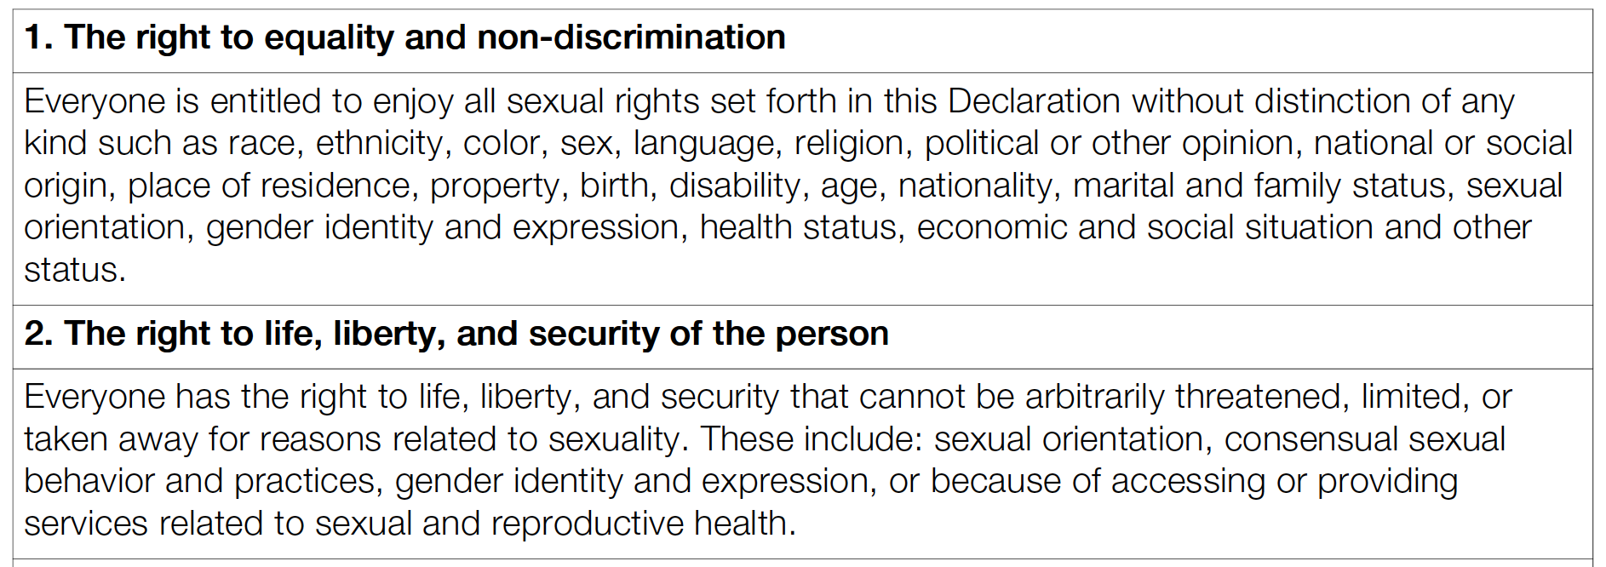
World Association for Sexual Health’s
“Sexual Rights are Human Rights Pertaining to Sexuality”

Slide 53
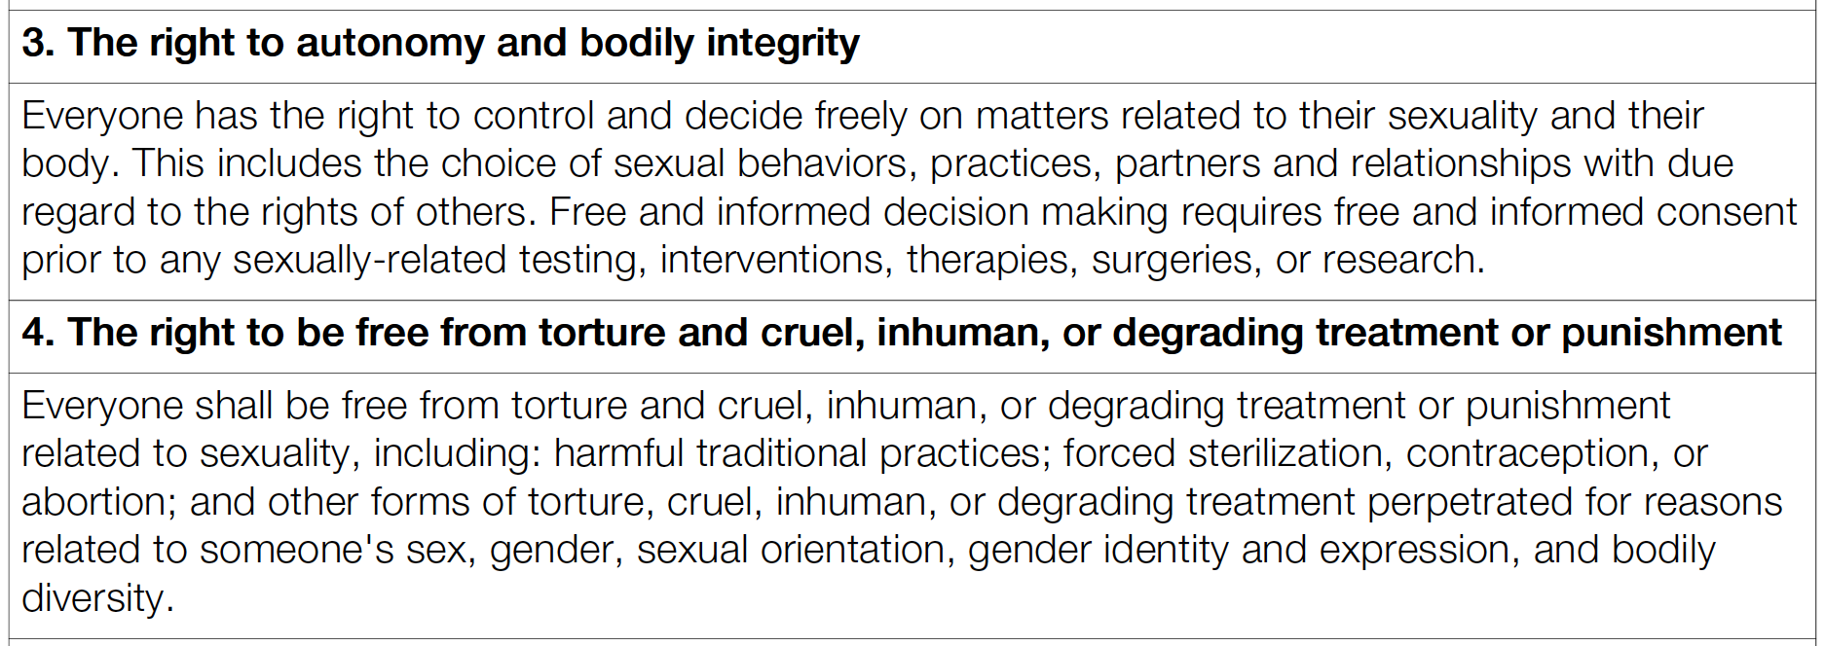
World Association for Sexual Health’s “Sexual Rights are Human Rights Pertaining to Sexuality”

Slide 54
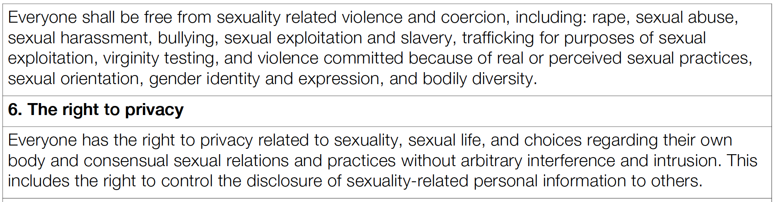
World Association for Sexual Health’s “Sexual Rights are Human Rights Pertaining to Sexuality”

Slide 55
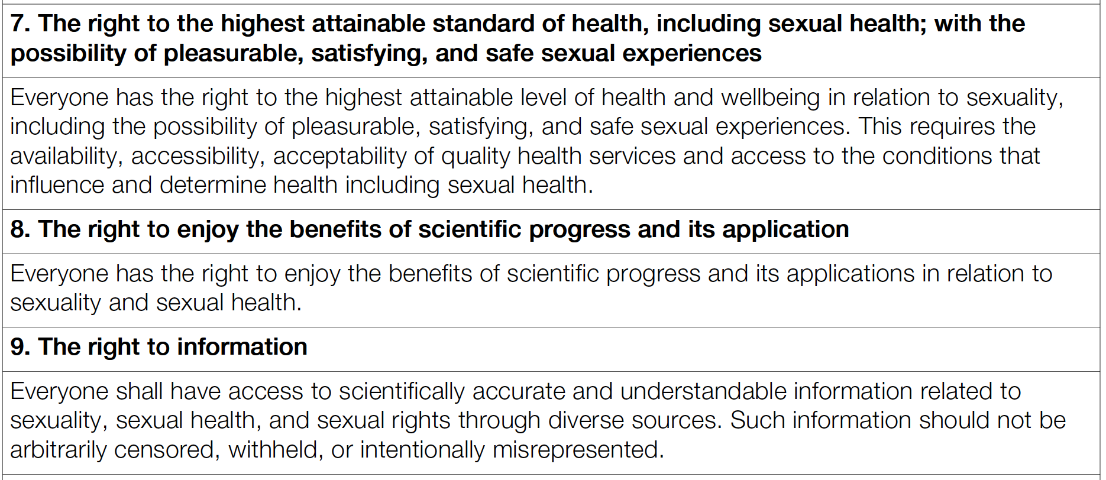
World Association for Sexual Health’s “Sexual Rights are Human Rights Pertaining to Sexuality”

Slide 56
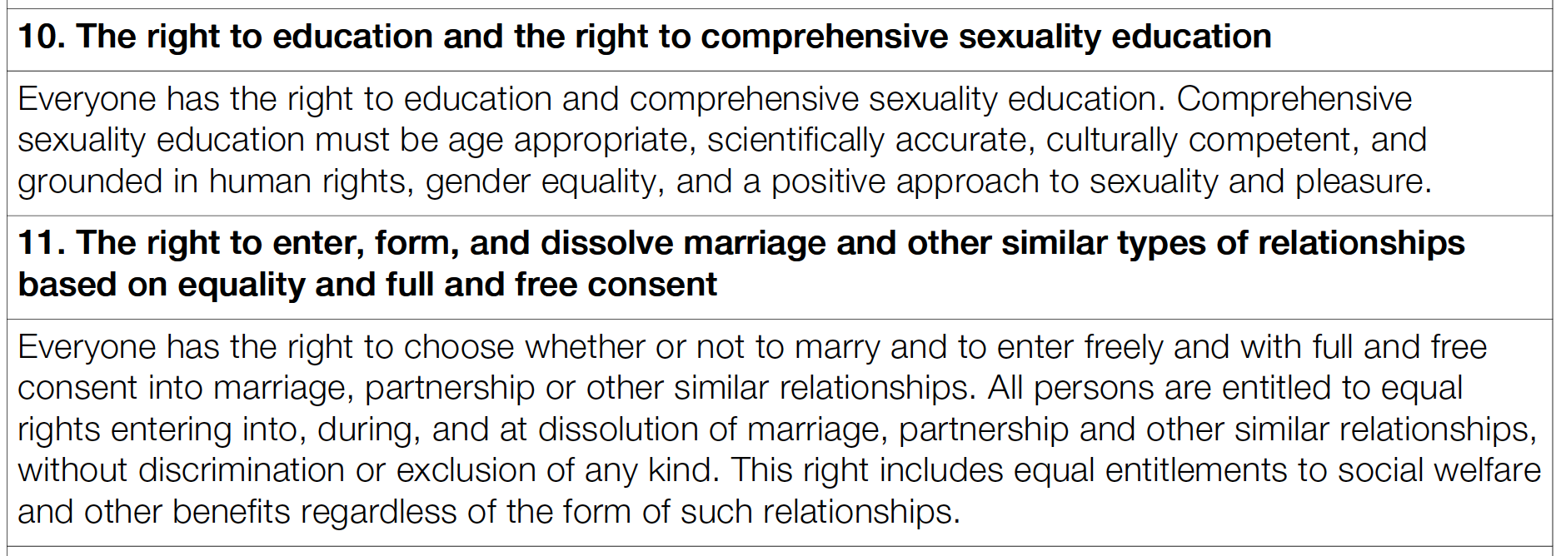
World Association for Sexual Health’s “Sexual Rights are Human Rights Pertaining to Sexuality”

Slide 57
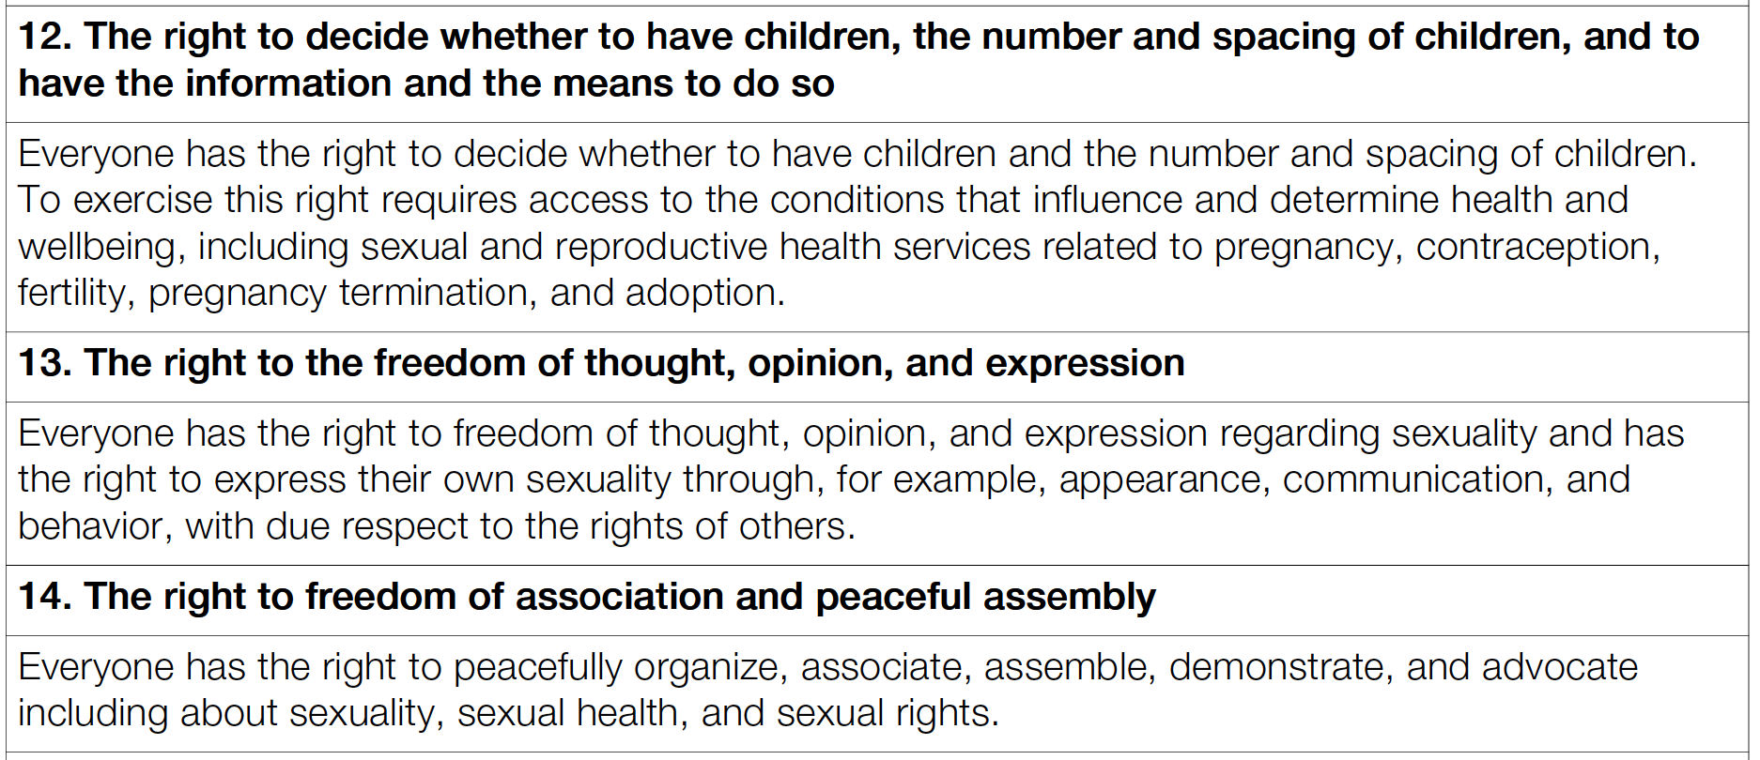
World Association for Sexual Health’s “Sexual Rights are Human Rights Pertaining to Sexuality”

Slide 58
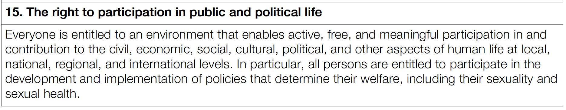
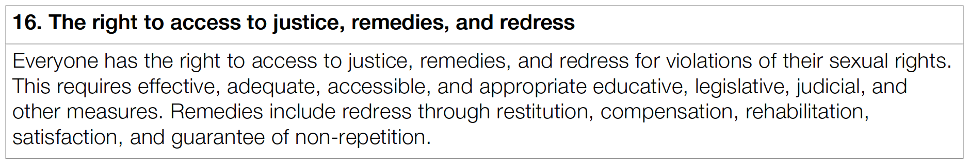
World Association for Sexual Health’s “Sexual Rights are Human Rights Pertaining to Sexuality”

